Slide 1
Secure Data Hiding in Images Using Steganography
CAPSTONE PROJECT
Presented By: Naga uday kumar Nandigam
Student name: Naga uday kumar Nandigam
College Name: Vikas college of pharmacy

Slide 2
OUTLINE
Problem Statement
Technology used
Wow factor
End users
Result
Conclusion
Git-hub Link
Future scope

Slide 3
Problem Statement
With increasing digital communication, sensitive data needs to be transmitted securely.
Traditional encryption methods are often detectable.
Steganography offers a way to hide data inside images, making it nearly invisible to attackers.

Slide 4
Technology used
Programming Language: Python
Operating system: windows
Libraries: OpenCV, PIL, Cryptography
Steganography Technique: Least Significant Bit (LSB) method

Slide 5
Wow factors
Invisible data hiding technique
Minimal visual distortion in the image
Secure extraction with a key-based system
Can be applied to real-world cybersecurity and watermarking scenarios

Slide 6
End users
Government agencies for secure communication
Cybersecurity professionals for data protection
Journalists and activists needing secure message transmission
Digital watermarking for copyright protection
Banking sector

Slide 7
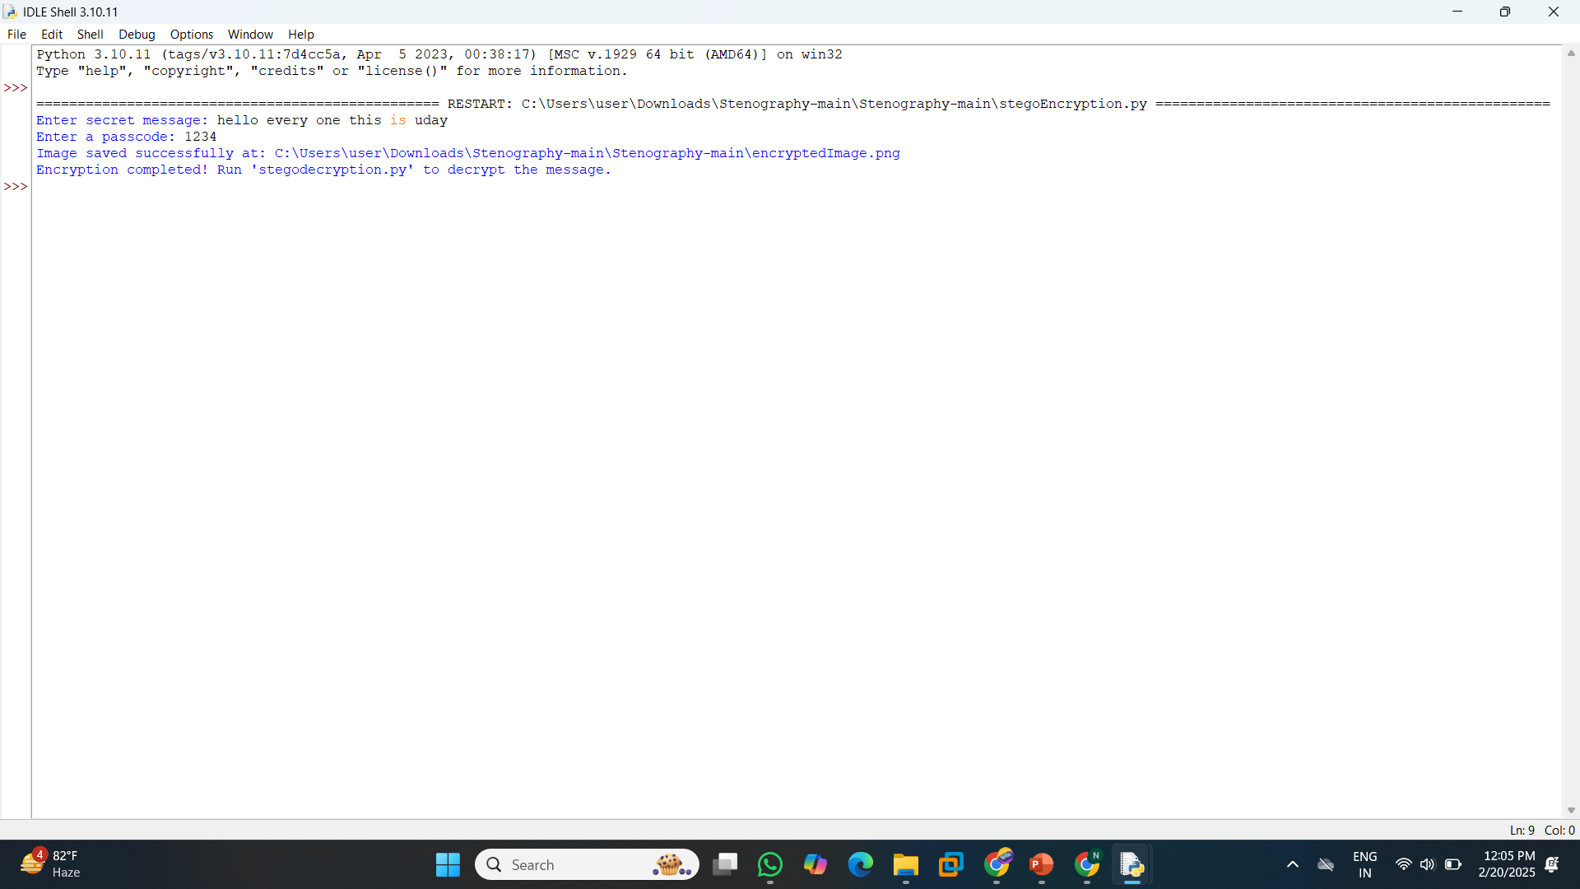
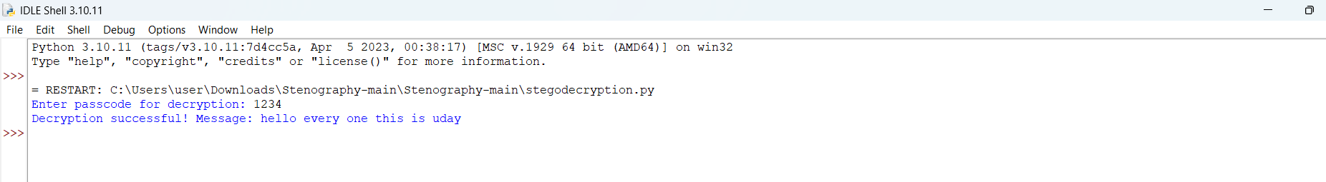
Results

Slide 8
Conclusion
This project demonstrates a secure way to hide sensitive information inside images. The approach ensures confidentiality while keeping the hidden message undetectable to unauthorized users.

Slide 9
GitHub Link
https://github.com/nagaudaykumarnandigam/Secure-Data-Hiding-in-Images-Using-Steganography.git

Slide 10
Future scope(optional)
Implementing more advanced steganography techniques (DCT, DWT)
Adding support for video and audio steganography
Enhancing security using encryption before embedding data
Developing a GUI-based tool for user-friendly implementation

Slide 11
THANK YOU

